Slide 1
Operating system
Part Review: Some questions

Slide 2
Review – Computations
CPU Scheduling
FCFS, SJF, SRJF, RR, Priority, MLQ, MLFQ, Lottery, HRRN
Synchronization
Semaphore based problems
Banker’s algorithm
MM replacement algorithms
FCFS, Optimal (MIN), LRU, Clock (2nd chance), LFU, MFU
MM Placement algorithms: Best, Worst, 1st, Next
Disk Scheduling
FCFS, SSTF (Shortest seek time first), Scan, C-Scan, Look, C-Look
File system
blocks needed, File size
Notes:
CPU, MM, HDD, File system

Slide 3
There are 4 processes sharing 18 resources. For dynamic avoid deadlock, the number of resources which every process could request at most is ()
A）4 B）5 C）6 D）7
Notes:
N*(P-1)+1<=R
4*(P-1)+1<=18
P-1<=17/4
P<=17/4+1=21/4
P could at most be 5

Slide 4
When using a counting semaphore to control the usage of 5 printers shared among many processes, which value could not occur for the counting semaphore?
A. -6 B.-5 C. 5 D. 6

Slide 5
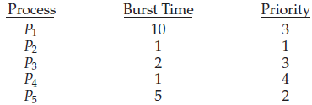
Typical questions
Consider the following set of processes, with the length of the CPU-burst time given in milliseconds:
The processes are assumed to have arrived in the order P₁, P₂, P₃, P₄, P₅, all at time 0.
Draw four Gantt charts illustrating the execution of these processes using FCFS, SJF, a non-preemptive priority (a smaller priority number implies a higher priority), and RR (quantum = 1) scheduling.
What is the turnaround time of each process for each of the scheduling algorithms in 1?
What is the waiting time of each process for each of the scheduling algorithms in 1?
Which of the schedules in part a results in the minimal average waiting time (over all processes)?

Slide 6
A multiprogramming system has one CPU and two IO devices – IO1 and IO2. The competition for CPU follows the preemptive priority scheme, which means the job with higher priority could interrupt the running job with lower priority and get the CPU. While, the competition for IO devices is non-preemptive.
Now there are three jobs – J1, J2 and J3 – stored in memory, and they arrive at same time. J1 has the highest priority and J3 has the lowest priority.
Their ordered requests for CPU and IO devices are listed as follows:
J1: IO2(30ms), CPU(10ms), IO1(30ms), CPU(10ms).
J2: IO1(20ms), CPU(20ms), IO2(40ms).
J3: CPU(30ms), IO1(20ms).
Please draw the Gantt diagram and answer the following questions:
Compute the turnaround time of those three jobs;
Compute the CPU utilization rate after all three jobs are finished;
Compute the utilization rate of IO1 after all three jobs are finished.

Slide 7

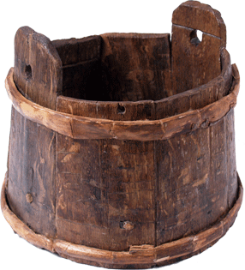
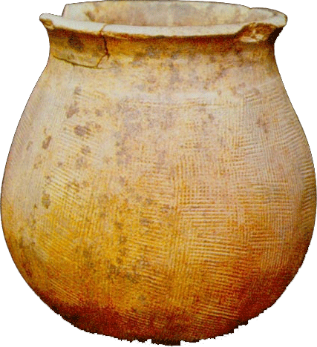
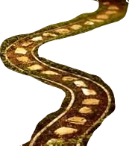

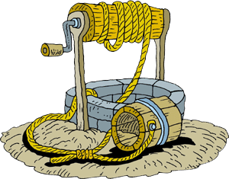
Notes:
Long ago there are many monks in a temple. Some were old and some were young. The young monks were bringing up water from a well. And the old monks can regale on it.
The well was too small to put one bucket every time.
Another vat [大桶] is in the kitchen. It can contain total 10 buckets water. Only one bucket can put in vat and fetch out water.
There are 3 buckets can be used by everyone.

Slide 8
General rules to cope with CS problem using semaphores
Find the types of actors
To determine the processes
Recognize the shared resources between actors
Infer the constraints based on the situations when actors use those shared resources
ME or SCH?
To determine semaphores and their initial values
To determine the code (nested for ME, and scattered for SCH)
Use semaphores to finish those processes

Slide 9
Readers-Writers Problem is a quite popular synchronization problem in OS.
One of its typical sub-problems is the First Readers-Writers Problem, in which readers have priority over writers.
That is, unless a writer has permission to access the object, any reader requesting access to the object will get it. (Note this may result in a writer waiting indefinitely to access the object, AKA starvation.)
Following is an unfinished pseudo code for this problem, please complete it.

Slide 10
Begin
readcountmutex, wmutex: semaphore; // 两个互斥信号量
readcount: Integer; // 面向Reader的计数器
readcountmutex = wmutex = 1;
rcount = 0;
Cobegin
Process procedure Reader
begin
repeat
// do something
P(readcountmutex);
______________________;
if (readcount ==1) then P(wmutex);
V(readcountmutex);
perform read operations;
P(_________________);
readcount:= readcount - 1;
if (__________________) then V(______________);
V(_________________);
// do something else
until false;
end
Process procedure Writer
begin
repeat
P(wmutex);
perform write operations;
V(wmutex);
until false
end
CoEnd
End

Slide 11
10.Figure 1 illustrates a bridge, and the arrows show the directions of the corresponding cars. Only one car is allowed on the bridge at any time, but several cars are allowed to pass the bridge one by one if they are for the same direction. You are required to fill the blanks in following code which is used to cope with this synchronization problem using P and V operations
Var integer mutex ，availn ，avails;
availn = m;
avails =0;
mutex = 1;

Slide 12
Wrong
Var integer mutex ，availn ，avails;
// availn (for North) and avails (for South) are semaphores to synchronize the passing cars
availn = m; // when it’s >0, it means only the cars from this direction could pass the bridge
avails =0; // when it’s 0, it means only the cars from this direction are forbidden to pass the bridge
mutex = 1; // mutual exclusion for accessing the bridge
COBEGIN
Car for South: Car for North:
BEGIN BEGIN
P(____________); P(__________);
P(____________); P(__________);
Cross the bridge; Cross the bridge;
V(___________); V(___________);
V(__________); V(___________);
END; END
Notes:
P(NS)
if (num_NS == 1) P(S);
num_NS++;
V(NS)
P(NS_Token);
…
V(NS_Token);
P(NS);
num_NS--;
if (num_NS == 0) V(S);
V(NS);

Slide 13
Assume that the main memory is organized using pure paging. The page table (uncompleted) is shown as Figure 2.
For each of the following decimal logical addresses, the physical addresses according to them are shown as follows.
Page table
0 | 4
1
2
3 | 3
4 | 1
logical addresses | physical addresses
0 | 2048
600 | 88
1024 | 0
Notes:
logical addresses physical addresses
0 2048
和
Page table
0 4
可一知道 Page 0 映射到 Frame 4, 而且, Frame 4 的初始地址是 2048
Frame 4 前 有0,1,2,3 共4 个Frame, 那么, 可知 Frame 的大小是 2048/4 = 512 = Page size

Slide 14
(1) Compute the page size.
(2) Fulfill the page table.
(3) For each of the following decimal logical addresses, compute the physical addresses according to the page table.
(3-1) 1600
(3-2) 2500

Slide 15
An OS uses demand paging system in memory management. Assume the capacity of the main memory which a process could be allocated to is 300 byte, which is divided into 3 frames. The process will access the following Logical address byte series: 115, 228, 120, 88, 446, 102, 321, 432, 260, 167（Attention: 115B is only equivalent to 1 page）.
Please Answer：
(a) Writing down the page-reference string.
(b) Analyze the page replacement situation and calculate the page fault frequency when LRU and FIFO algorithm is used

Slide 16
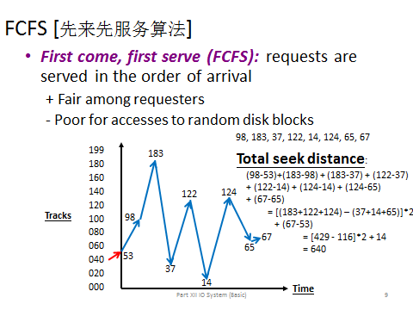
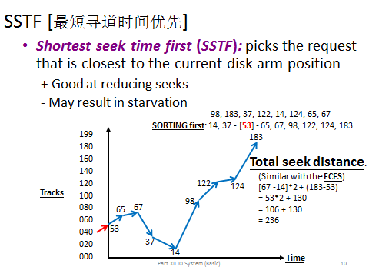
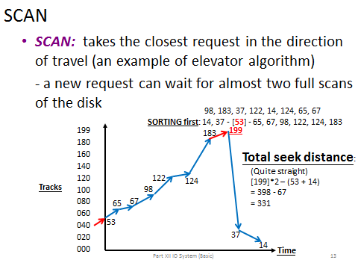
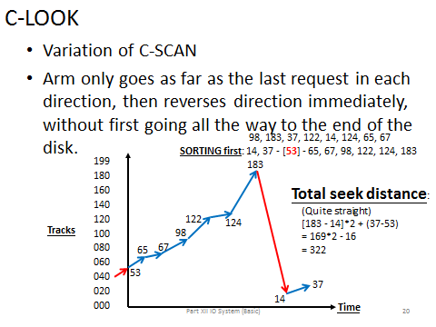
Disk scheduling algorithms
We illustrate them with a request queue (0-199).
98, 183, 37, 122, 14, 124, 65, 67
After visiting 40, current Head pointer is at 53
FCFS, SSTF, SCAN, C-SCAN, LOOK, C-LOOK

Slide 17
Typical questions for file system + Device management
A hard disk has 40G, Its each block size is 1K，and each table entry of FAT needs 20 bits，then Its FAT (File Allocation Table) need （ ）memory space
A）100M B）120M C）140M D）160M
How about using bit map?

Slide 18
Here is a file system, which adopts multi-level index structure to support the search some records in a file.
The block size is 512 bytes, and 3 bytes are used to represent the block number.
If the cost to the logic block number in a physical block is not considered, please figure out the largest size of a file when using 2-level and 3-level index structures.

Slide 19
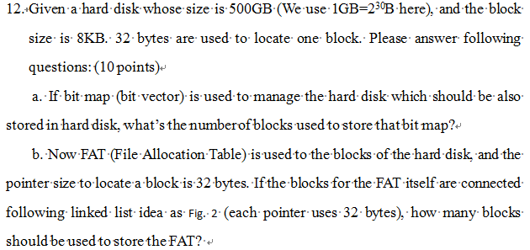

Slide 20
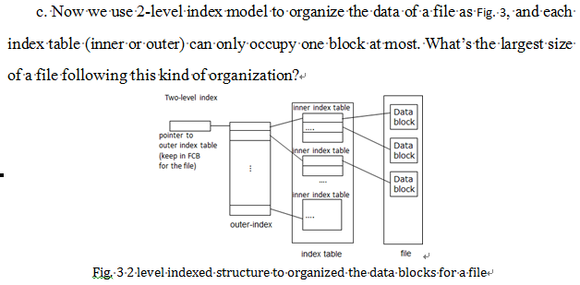

Slide 21
